Slide 1
Optical Box for Optical Computing
Optical Box Math

Slide 2
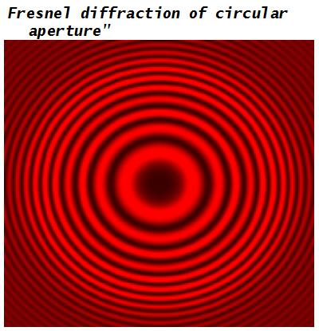
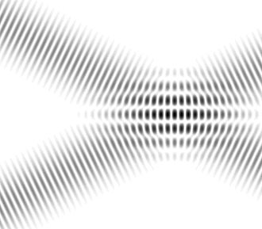
What is Optical Computing
Numbers
Real as Amplitude of Complex EMW Vector
Operations
Rough calculations of Amplitude of Random Vector to Predefined Matrix multiplication
Do all math calculations parallel with one step for all signal points
Operates with Complex EMW vectors
Rough Arithmetic Calculations
Using Interference and Diffraction of light (EMW)

Slide 3
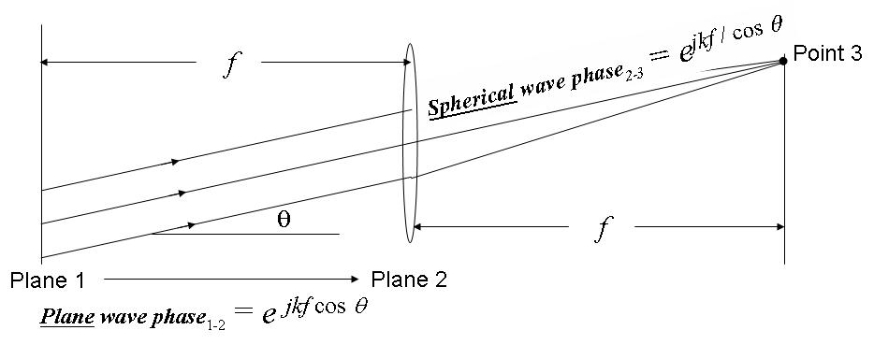
Fourier transforming property of lenses

Slide 4
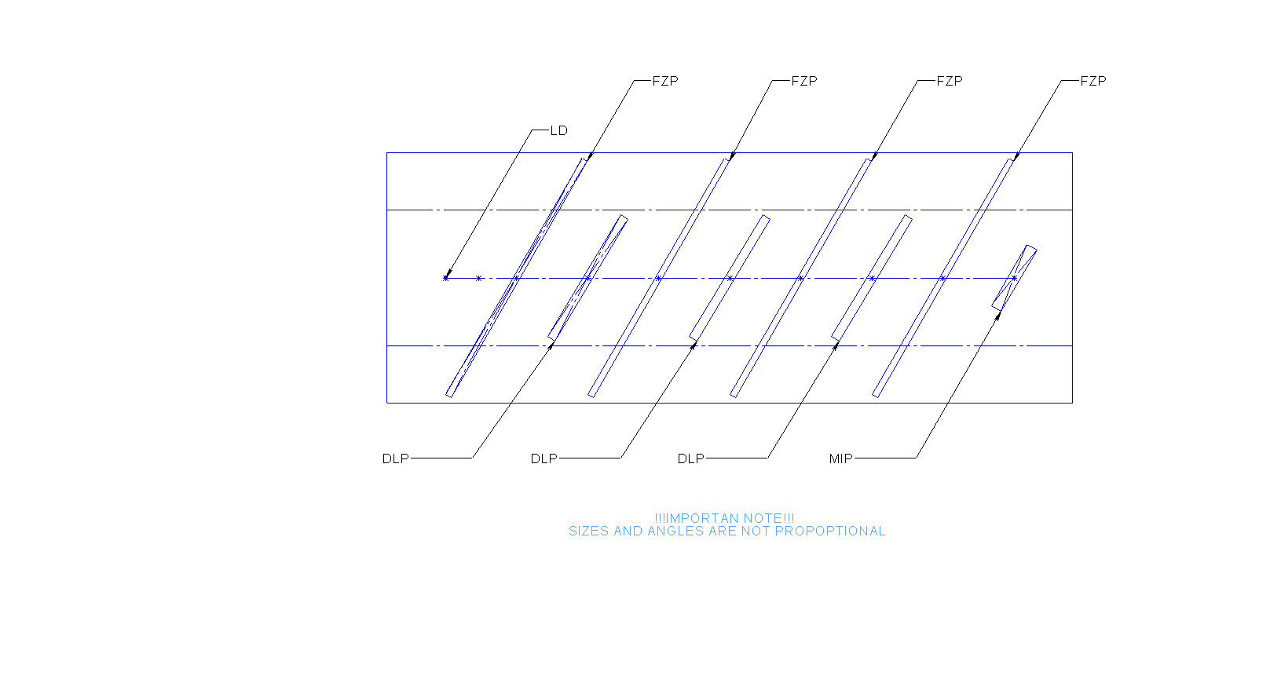
Optical Box Model

Slide 5
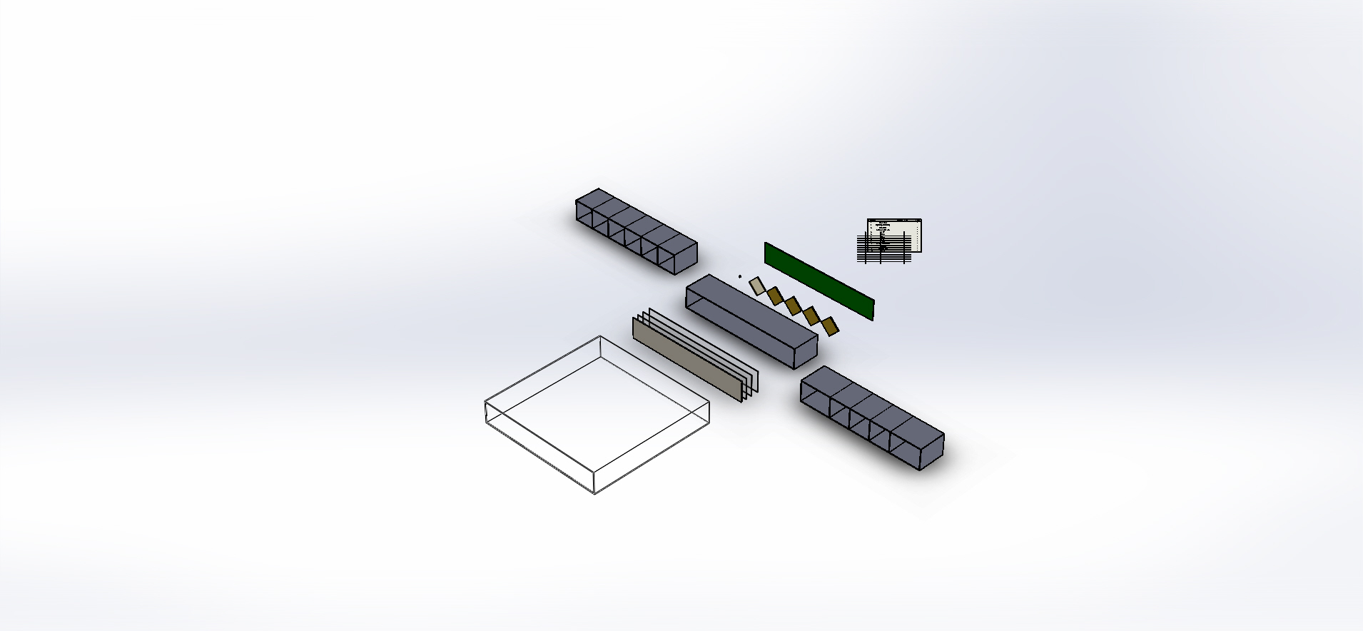
Optical Box Design

Slide 6
Optical Box Design Description
Chips of LD, DLPs and MIS are mount on one side of a Circuit Board in row with equal step. LD and MIP are placed at left and right DLPs are placed in the middle.
The Circuit Board is places at one side of a Frame
At another side of the Frame placed a Film with printed FZPs, a Polarizing Filter, a Color Filter and a Mirror
Sizes of the Circuit Board, the Film with FZPs, the Polarizing Filter, the Color Filter and the Mirror are equal
A number of printed FZPs is equal a number of DLPs plus two half-sized FZPs for LD and MIS
To remove wrong light rays LD, DLPs, FZPs and MIS have collimator shutters
Light from LD multiply time pass thru FZP and reflect from Mirror on a second side of the Frame or reflect from DLP on a first side of the Frame until MIS catch a ray.
Distances between a pair of LD-FZP or FZP-DLP or FZP-MIS are equal
DLP or MIS can be combined from number of chips
Some DLP can be replaced by mirrors to reduce number of DLP chips

Slide 7
Optical Box Design Description
A number of single Optical Boxes can by stacked or combined
DIPs and MISs can be placed as 1D or 2D arrays
Optical Box can be equipped by
An internal memory to fast read MIS values and write DIPs values
An embedded computer with embedded software
An Ethernet port
A front panel
A power supply
19’’ rack mount kids

Slide 8
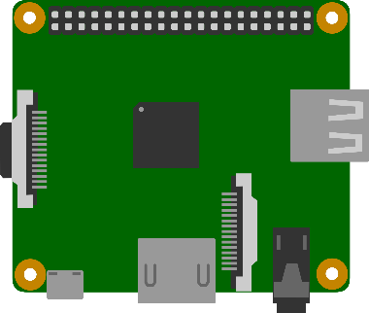

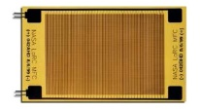

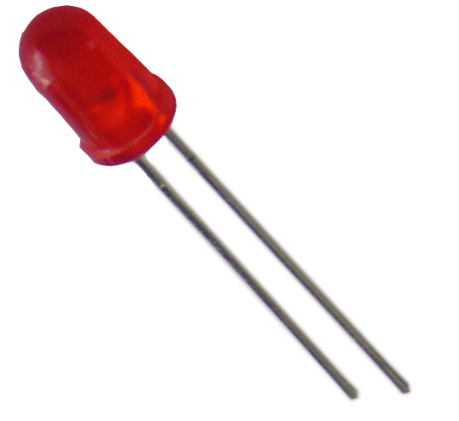
Embedded Hardware Architecture
Ethernet
Serial
HDMI
USB

Slide 9
Embedded Software Architecture
TCP/IP
Localhost
VLC
MOTION

Slide 10



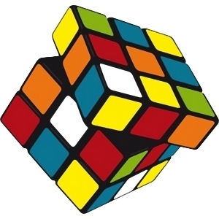
Optical Box Math Model

Slide 11
Optical Box Math
Optical Box Design do parallel math calculations of signals on DLP
Optical Box Design do not calculate Fourier transforming
Optical Box Design do calculate Some (Unknown, depended from device implementation) Matrix Multiplication transforming of signals on each FZP
Because Optical Box Design has more then two DLP
Reverse of Unknown Matrix
Can be calculated by experiments (during Optical Box Calibration)
Can be saved for future use in embedded memory of Optical Box
Can be used for calculation needed
One DLP (if light is high polarized) or two DLP (if light is low polarized) can be used to correct total matrix production for calculation needed like Fourier transforming, Walsh-Hadamar transforming and etc.

Slide 12
Optical Math Laws
Classical view to Optical Box Model give us a formula suggested
Y = | X1 * M1 x X2 * M2 x X3 * M3 … |
Where are X1, X2, X3 … is real values of DLPs,
M1, M2, M3 … is complex transformation matrices depended from current device
Operator “x” – by-item vector multiplication
Operator “*” – vector-to-matrix multiplication
Operator || - by-item amplitude taken
This formula suggested is based on classical linear optics with ideal light, precision sizes, etc. and is not valid for us because we are use Interference and Diffraction of light (EMW) on a real not high-precision device.
If Interference and Diffraction of light (EMW) the result effect is more complex and optic physics can guaranty only
dYi = | gi(X1,…Xi) + dXi*Mi |
Or dY = | g(X1,…,Xn) + dXn*Mn |
Where are g – non-linear function, low depended from O(dXn)

Slide 13
Optical Box Calibration Procedure
Let we need calculate fast Y=| X*M | where M – transform matrix like forward or backward Fourier transforming, Walsh-Hadamar transforming or any another linear transform we need.
If Y = OUTPUT(X1,X2,X3,…) is an output from Optical Box with X1, X2, X3 … values of DLPs
Let calculate with using PC and Optical Box both function
F(X1,…,Xn-1) = max || OUTPUT(X1,…,Xn-1,X) - | X*M | || for all X
Where || a - b|| is difference of two vectors
For fixed X1,…,Xn-1 to find out max || OUTPUT(X1,…,Xn-1,X) - | X*M | || optimization algorithms of nonlinear function can be used as described in many student materials.
Calculations of || OUTPUT(X1,…,Xn-1,X) - | X*M | || are usualy fast
Main task is find out C1,…,Cn-1 such F(C1,…,Cn-1 ) = min F(X1,…,Xn-1) for all X1,…,Xn-1
optimization algorithms of nonlinear function can be used as described in many student materials too.
Values C1,…,Cn-1 will be named Calibration for transformation matrix M and
Y=| X*M | = OUTPUT(C1,…,Cn-1,X)
Where OUTPUT(C1,…,Cn-1,X) is an output from Optical Box with C1,…,Cn-1, X values of DLPs

Slide 14
Optical Box Calibration Definition
If Y = OUTPUT(X1,X2,X3,…) is an output from Optical Box with X1, X2, X3 … values of DLPs
If F(X1,…,Xn-1) = max || OUTPUT(X1,…,Xn-1,X) - | X*M | || for all X
If F(C1,…,Cn-1 ) = min F(X1,…,Xn-1) for all X1,…,Xn-1
Then values C1,…,Cn-1 will be named Calibration for transformation matrix M and
Y=| X*M | = OUTPUT(C1,…,Cn-1,X)
Calculations can be done with PC and Optical Box together or within Optical Box only using embedded discrete computer

Slide 15
Optical Box Calibration Size
Optical Box OUTPUT(X1,…,Xn-1,X) define COUNT(X1,…,Xn-1) functions like
G(X)= OUTPUT(X1,…,Xn-1,X)
Because RANG(X1,…,Xn-1) > RANG(X)
Then not all functions like G(X)= OUTPUT(X1,…,Xn-1,X) are linear
But Optical Calculations with single lens in ideal conditions generate only linear transformations due EMW Composition Principle.
Therefore Calibration allow to remove non-linear distortion due non-ideal conditions of single lens transformation.
Non-ideal light
Non-Monochrome
Non-Polarized
Many Independent Sources and Additional Reflections
Non-ideal geometry and etc.

Slide 16
Minimal Optical Box Calibration Size
Calibration allow to remove non-linear distortion due non-ideal conditions of single lens transformation.
The main distortion for Interference and Diffraction of light caused by Non-Polarized light. Some materials can change light polarization during light reflection or pass thru transparent material.
EMW consists of Electric and Magnetic Parts
If light is Non-Polarized Electric(or Magnetic) Parts of two beams are not summarize as values but summarize as direct vectors so light detector catch average power for all cells and do not recognize Interference/Diffraction picture of two beams of light.
Electric and Magnetic Parts of any EMW can be present as complex number or as a pair of real numbers
Calibration which can remove distortion caused by Non-Polarized light must contains a pair of real calibration values for any output amplitude value at point as real number.

Slide 17
Optical Box Calculations Precision
Fact
Calculation with using optics calculations gives rough results
Solution Ways
Same algorithms like sorting, brute force, branch-and-bounds and etc. do not need precision for all results but selected only. Selected results can by calculated traditional way.
There are many step-by-step math iteration algorithms exists to up precision as needed
Conclusion
Rough results can by used effectively

Slide 18
DLP Usage Notes
Usual DLP chip micro-mirrors have 3-state (3 micro-mirror reflection angle)
Parked
On or Off
Technology to generate grayed image by fast switch between On and Off states used by video projectors is not applicable by Optical Computing.
Solution Ways in case using DLP chip of micro-mirrors with limited states is
Do calculations with 1-bit numbers and apply iteration math algorithms to up precision
Use group of micro-mirrors to generate gray color
Another way to use micro-mirrors with 3-state in binary mode in case of slow MIS is
Transparent = Parked state
Opaque = fast random switch between On and Off states.
fast random switch between two states will generate average energy picture caused random diffraction pictures cached by MIS

Slide 19
Thank You
Contacts
Dmitry Protopopov, Moscow, Russia dmitry@protopopov.ru +7 916 6969591
Taras Kovtun, Boca Raton, FL, USA boss@rbadesign.us

